Slide 1

AngularJS Overview
Date : Nov 15, 2016
BISWA RANJAN

Slide 2

Agenda
Introduction – Why you should be using AngularJS
Single Page Application (SPA)
Downloading AngularJS and Understanding API
Terminology – The critical foundation for understanding
Modules – Reusable functionality
Controllers – Facilitating communication between the model and the view
Filters – Changing the way you see things
Demo – Words in action
Conclusions – The end is nigh

Slide 3
Objectives
To give you a core objective to understand all of the terminology with example and documentation out there.
I will cover…
Why?
What?
How?
I will very briefly cover how to build your first AngularJS application.

Slide 4
Introduction
First off, why use JavaScript?
To dynamically update your HTML document and to get data to and from it.
AngularJS is a framework (a JavaScript library) that makes it easier to communicate between your HTML document and JavaScript.
To make the development of web apps easier and faster
HTML with a native Model-View-Controller (MVC) capabilities.
extends HTML attributes with Directives, and binds data to HTML with Expressions

Slide 5
Single Page Application
1. HTML is a great declarative language for static documents.
- It does not contain much in the way of creating applications,
2. One "real" HTML page whose content can be changed in JavaScript without having to download a new page.
- The new content is created programmatically using templates.
- Performances is better since not downloading a new HTML page each time while navigating
3. No server-side page rendering

Slide 6
Characteristics Single Page Application:
Chunking
the web page is constructed by loading chunks of HTML fragments and JSON data instead of receiving full HTML from a web server on every request.
Controllers
JavaScript code that handles complex DOM and data manipulations, application logic and AJAX calls is replaced by controllers that separate views and models using MVC or MVVM patterns.
Templating
coding of UI and DOM manipulations are replaced by declarative binding of data to HTML templates.

Slide 7
Downloading AngularJS
Can be download from http://angularjs.org/
Added to a web page with a script tag.
<script src="Scripts/angular.js"></script>
Can also be added through latest CDN link
<head>
<title>Learning AngularJS</title>
<script src=https://ajax.googleapis.com/ajax/libs/angularjs/1.0.7/angular.min.js ></script>
</head>
There are two types of angular script URLs we can point to,
angular.js
This is the human-readable, non-minified version, suitable for web development.
angular.min.js
This is the minified version, usually used in production.

Slide 8
Building Blocks AngularJS
View Component
what the user sees (the DOM)
Directives
extend HTML with custom attributes and elements
Controllers Component
the business logic behind views
Model Component
the data shown to the user in the view and with which the user interacts
Filters
formats the value of an expression for display to the user
Services
reusable business logic independent of views
Dependency Injection
Creates and wires objects and functions

Slide 9
Model View Controller
What is the MVC?
Model – the data
View – the user interface, what the user sees and interact with
Controller – the interface between the model and the view
The model is not necessarily the data from the database.
The browser, server, and database can have their own MVC systems and often do.
When we talk about the MVC in this presentation we’ll be talking about the MVC on the browser.

Slide 10
Directives
Used to extend HTML ,understandable to AngularJS.
Directives are HTML attributes with an ng prefix.
Can use data-ng- to make it HTML5 compliant
ng-App.
Best Practice is to put to the parent tag <html>
Indicate the AngularJS compiler that this part of the page is an angular module/application.
defines the root element of an AngularJS application.
Will automatically initialize the application when page is loaded.

Slide 11
Directives
ng-bind
binds the innerHTML of the element to the application variable .
Uses one way data Binding ($scope->view)
Has shortcut {{ }} do display scope value
ng-model
binds the value of HTML controls to application data.
Provide CSS classes for HTML elements.
Has two-way data binding
($scope --> view and view --> $scope)
Bind HTML elements.
<input ng-model="val"/>.

Slide 12
Directives- Example-I
<!DOCTYPE html>
<head>
<title>Directive Example-One</title>
<script src="Scripts/angular.js"></script>
</head>
<body>
<div ng-app="">
<label>First Name</label>
<input type="text" ng-model="name">
<p ng-bind="name"></p>
</div>
</body>
</html>

Slide 13
Data Binding
Binds data to HTML using Expressions {{ expression }}.
- Expressions are written inside double braces:
- Same way as the ng-bind directive.
They can contain literals, operators, and variables.
Will "output" data exactly where the expression is written.
<div ng-app="">
<label>First Name</label>
<input type="text" ng-model="name">
{{name}}
</div>

Slide 14
Expressions
What is a JavaScript expression?
An expression produces a value and can be written wherever a value is expected.
AngularJS also has expressions:
Angular expressions are JavaScript-like code snippets that are usually placed in bindings such as {{ expression }}.
myvar 3 + x myfunc("a", "b")
<form> <p> Enter your name: <input type="text" ng-model="name" required> <button type="button" ng-click="submit()" ng-disabled="!name">Submit</button> </p> <p ng-show="name"> Hello, {{name}}
</p> </form>

Slide 15
Scope
What is scope?
It is the context in which an expression is evaluated.
This example has three scopes, one of which inherits a variable from its parent scope.
function foo() { var name = “ALL"; function hello() { var name = “Biswa"; return "Hello, " + name; } function goodbye() { return "Good bye, " + name; } hello(); //returns "Hello, Biswa" goodbye(); //returns "Good bye, ALL"; }

Slide 16
Modules – Reusable functionality
What is a module?
A container for code for the different parts of your applications.
A module is used to define services that are reusable by both the HTML document and other modules:
Controller
Directive
Constant, Value
Factory, Provider, Service
Filter
Best Practice: Divide your code into modules with distinct functionality. Don’t put everything in one module.

Slide 17
Module Definition
Define a module:
Define a module with dependencies on other modules:
Get an existing module:
var module = angular.module('myModule', []);
var module = angular.module('myModule', ['otherModule']);
var module = angular.module('myModule');

Slide 18
Application Module
AngularJS provides a way for you to bind your main module to the HTML document using the ng-app directive.
HTML fragment JavaScript fragment
<div ng-app='myApp'> ... </div>
angular.module('myApp', []);

Slide 19
Controllers
Functions used to initialize the model objects:
A new Controller object is instantiated , using the specified Controller's constructor function.
A new child scope will be available as an injectable parameter to the Controller's constructor function as $scope.
Use controllers to:
Set up the initial state of the $scope object.
Add behavior to the $scope object.
Controllers should contain only business logic.

Slide 20
Controllers
ng-controller
Directive defines the controller.
Gets executed when the page loads.
Attribute on a DOM element says that all of the elements inside of it belong to the controller.
The value should also be the name of the function .
They have special parameters with fixed names like $scope.

Slide 21
Example:
<div ng-app="" ng-controller="showHideController">
<div id="left">
<img src="Images/orderedList1.png" ng-show="status" />
</div>
<label>First Name</label>
<input type="text" ng-model="name">
<p ng-bind="name"></p>
<button ng-click="show()">Hide Image</button>
</div>
<script>
function showHideController($scope) {
$scope.status = true;
$scope.show = function () {
$scope.status = false;
} }
</script>.

Slide 22
Filters
Used for transforming the data for display used along with expressions.
Can also be added to directives using a pipe (|) character
multiple filters can be used by using two or more pipes.
To use the uppercase filter,
<p>The First name is {{ firstName | uppercase }}</p>
We can also use filters from within JavaScript by using the $filter service.
app.controller('DemoController', ['$scope', '$filter',
function ($scope, $filter) {
$scope.name = $filter('lowercase')(‘Ramesh');
}
]);

Slide 23
Filters
Currency
Format a number to a currency format.
Select
A subset of items from an array.
Lowercase
Format a string to lower case.
Order By
Orders an array by an expression.
Uppercase
Format a string to upper case.

Slide 24
Filters
HTML Example JavaScript Example
<div ng-app='myApp' ng-controller="myController"> <p>{{name | uppercase}}</p> <p>{{uppercaseName()}}</p> </div>
var module = angular.module('myApp', []); module.controller('myController', [ '$scope', '$filter', function($scope, $filter) { $scope.name = ‘Biswa Ranjan'; $scope.uppercaseName = function() { return $filter('uppercase')($scope.name); }; }]);

Slide 25
Filters with Parameters
HTML Example JavaScript example
{{ expression | filterName : param1 : param2 }}
$filter('filterName')(expression, param1, param2);

Slide 26
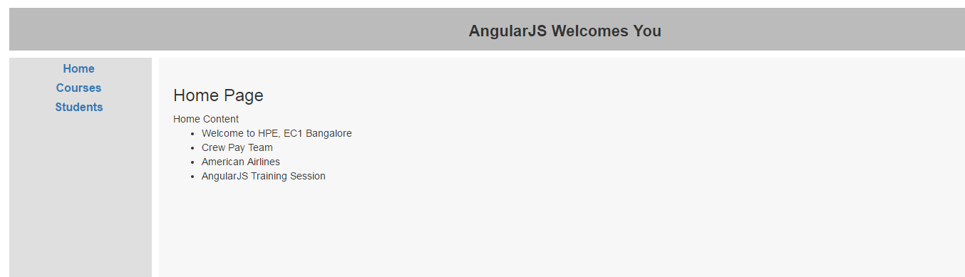
Demo Application

Slide 27
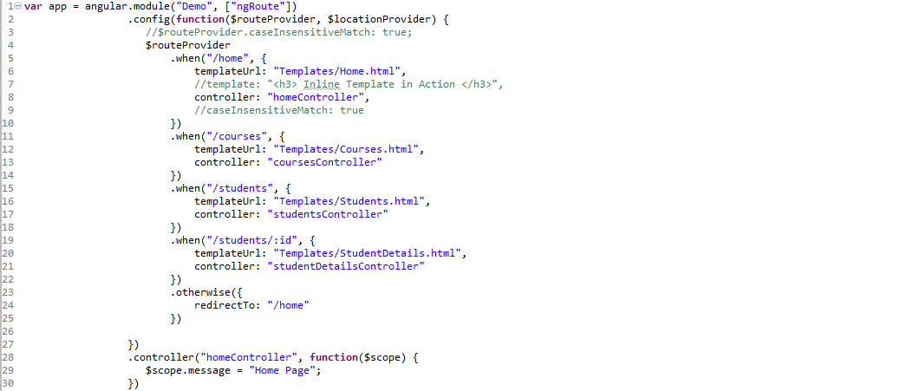
Example Application: script.js

Slide 28
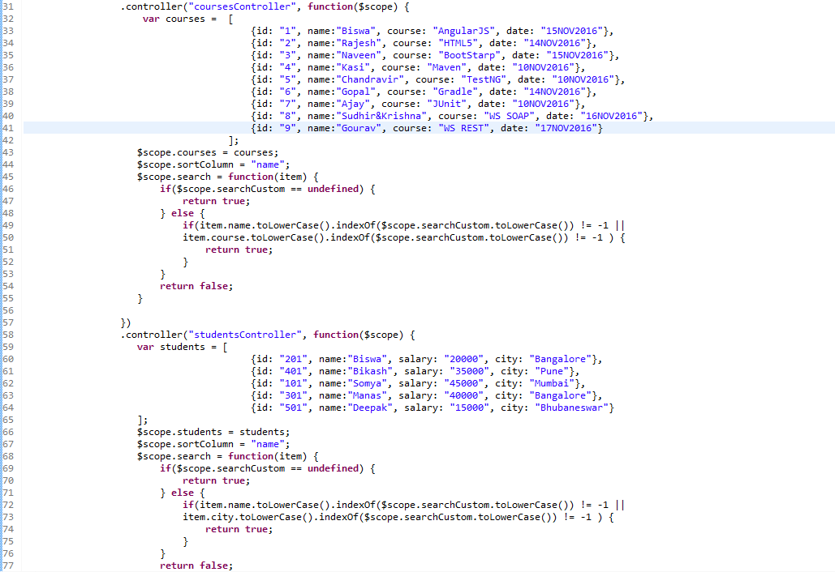

Slide 29
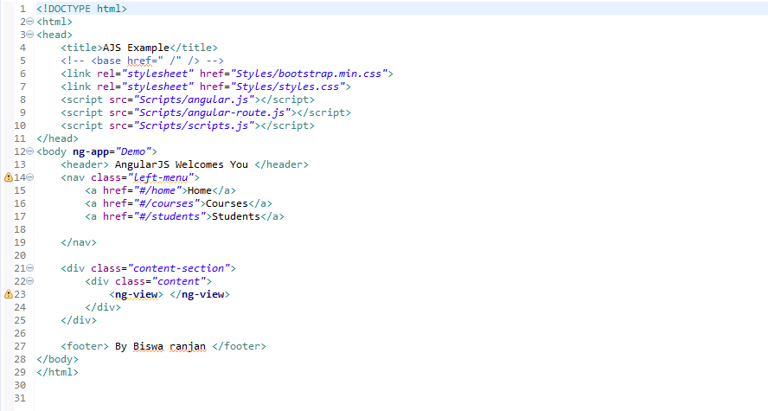
Demo Application: index.html

Slide 30
Great Resources
Official Tutorial – https://docs.angularjs.org/tutorial
Official API – https://docs.angularjs.org/api
Developer Guide – https://docs.angularjs.org/guide
Articles, explanations, tutorials – http://www.ng-newsletter.com/

Slide 31



